Slide 1

Intelligent Recommendation
CS-410 project by Team RS4
Rudranil Deb Roy – Rdebroy2
Shaleen Mehrotra – Shaleen3 (Captain)
Shruti Kalia – Skalia2
Sujan Das – Sujan2
Sreyashi Das – Das25

Slide 2
Description Of The Project
IntelliReco (An intelligent recommendation system)
The main functionality of the application is to provide the user with recommendations of products from the Amazon marketplace based on user’s keyword input criteria.
The application provides an User Interface to interact with the system and get recommendations by choosing a category and supplying a few product-related keywords.
The User Interface also provides a dashboard for an easy graphical overview of the products in the system.

Slide 3
Software/Tools Used
Backend:
Python 3 (3.7.x), Flask Server
Front end:
React (NodeJS), JavaScript, React-Google-Charts, Material UI
Tools:
NLTK, Scikit Learn, Numpy, beautifulsoup4, urllib3, requests, selectorlib
Database:
SQLite

Slide 4
How To Install and Run
Clone the git repository and navigate to <root-project-folder>\flask-server.
Run command pip install -r requirements.txt. (In case of error, libraries can be installed one by one using npm)
Navigate to <root-project-folder>\flask-server/dataload folder.
Run command python server.py to start the backend web server on port 5000
For running the UI project, NodeJS should be already installed.
Navigate to <root-project-folder>\intel-reco-ui folder.
Run npm install to install the required libraries needed by the project.
Run npm start to start the UI on port 3000. (best browser to use : Google Chrome)

Slide 5
How To Use The Application
Once application is started, below steps can be followed:
Navigate to localhost:3000 (Preferred Browser: : Google Chrome)
Login Screen appears but uses default user details populated. Click on login.
Click on Dashboard link on the left page navigation. Provides graphical overview of products.
Click on the Recommendation on the left page navigation.
Select the category of the product and enter few keywords. (e.g. hoodies and Nike)
Click on Recommend button to view the results below on the same page
Click open_link to open the product page on the marketplace
Continue Steps above to search for more results.

Slide 6
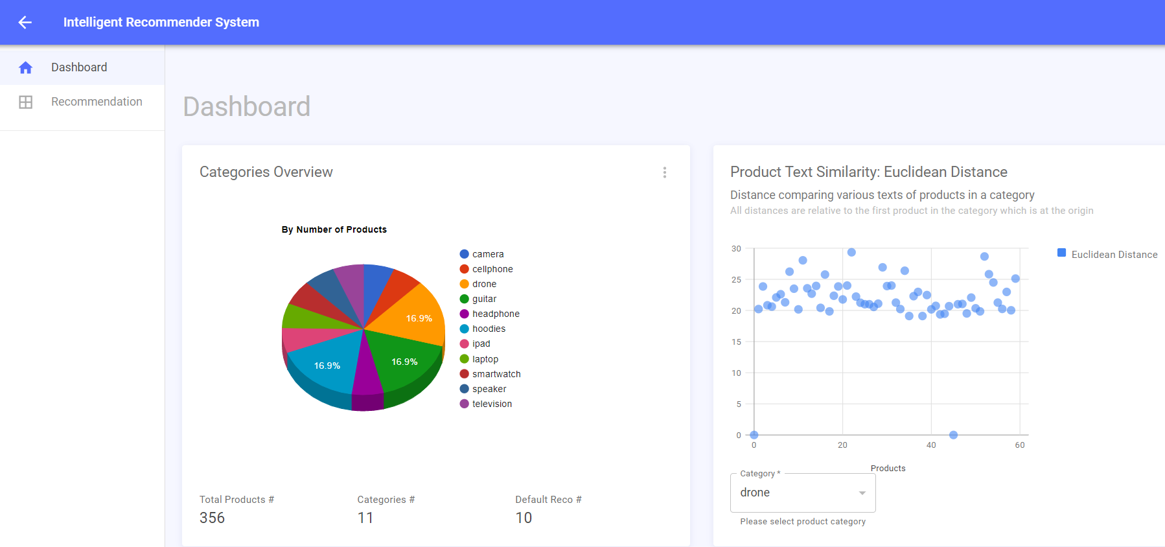
IntelliReco: Dashboard page

Slide 7
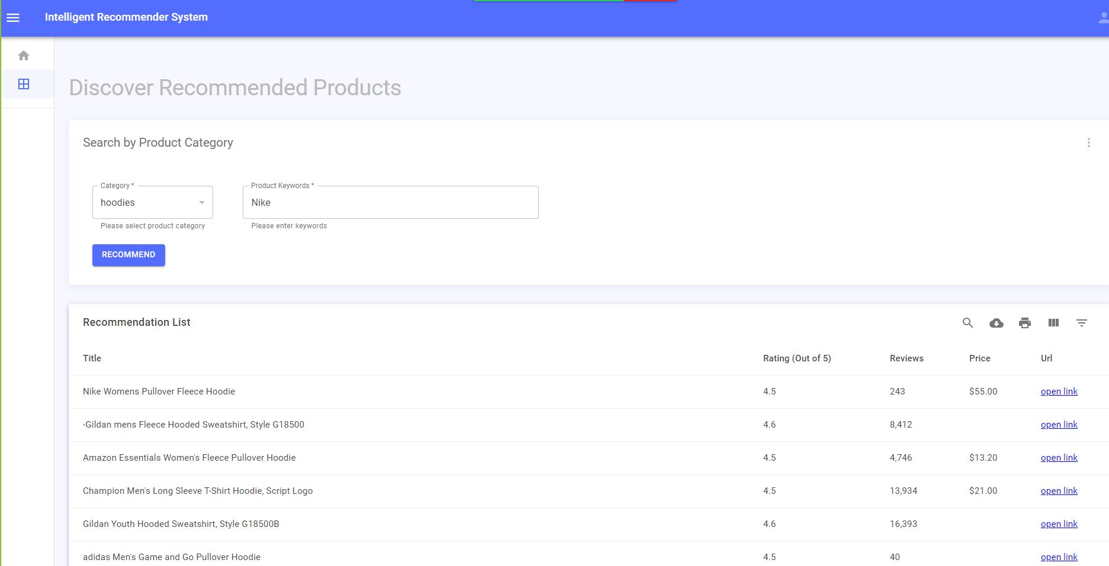
Use Case 1 Category as “hoodies” and Keyword as “Nike”

Slide 8
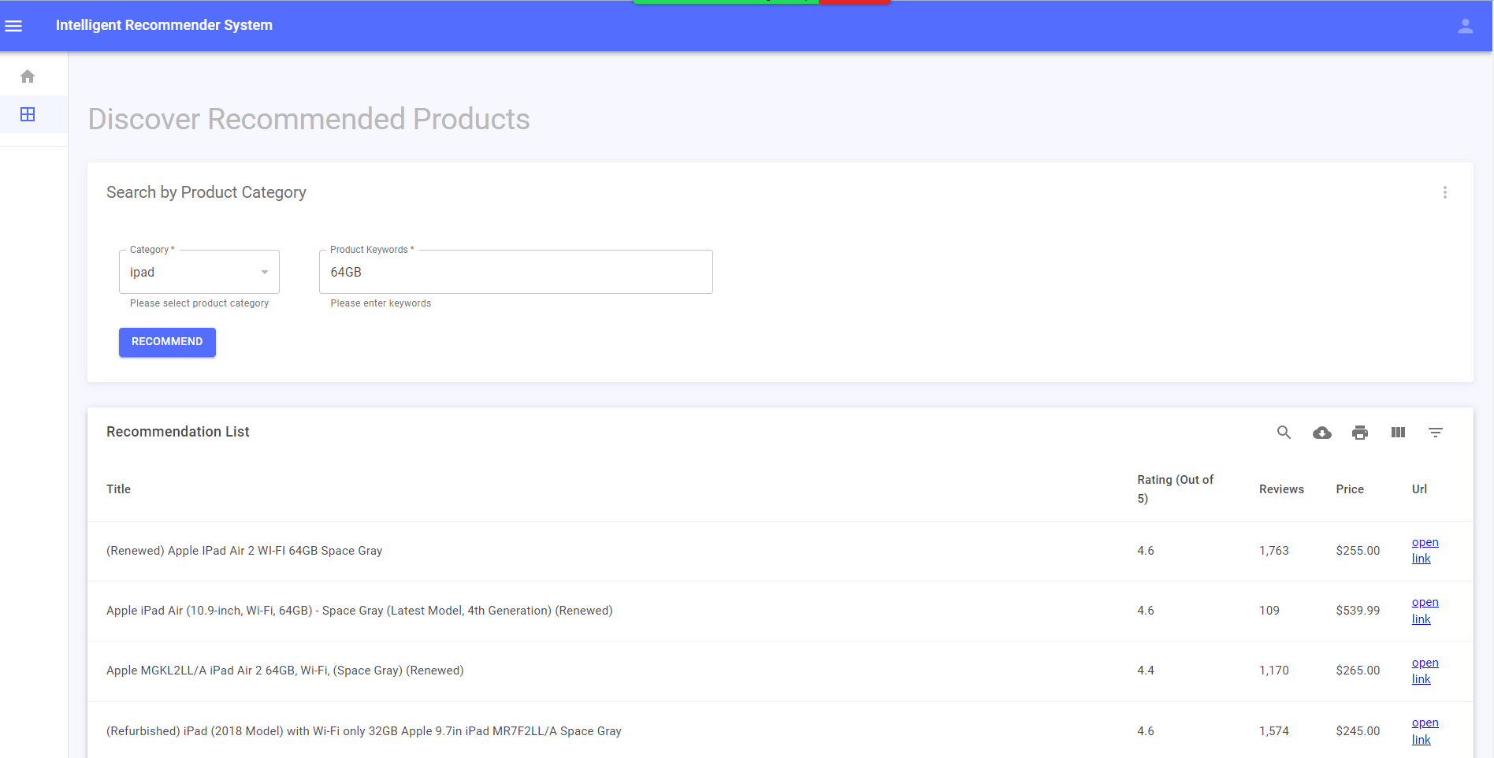
Use Case 2 Category as “ipad” and Keyword as “64GB”

Slide 9
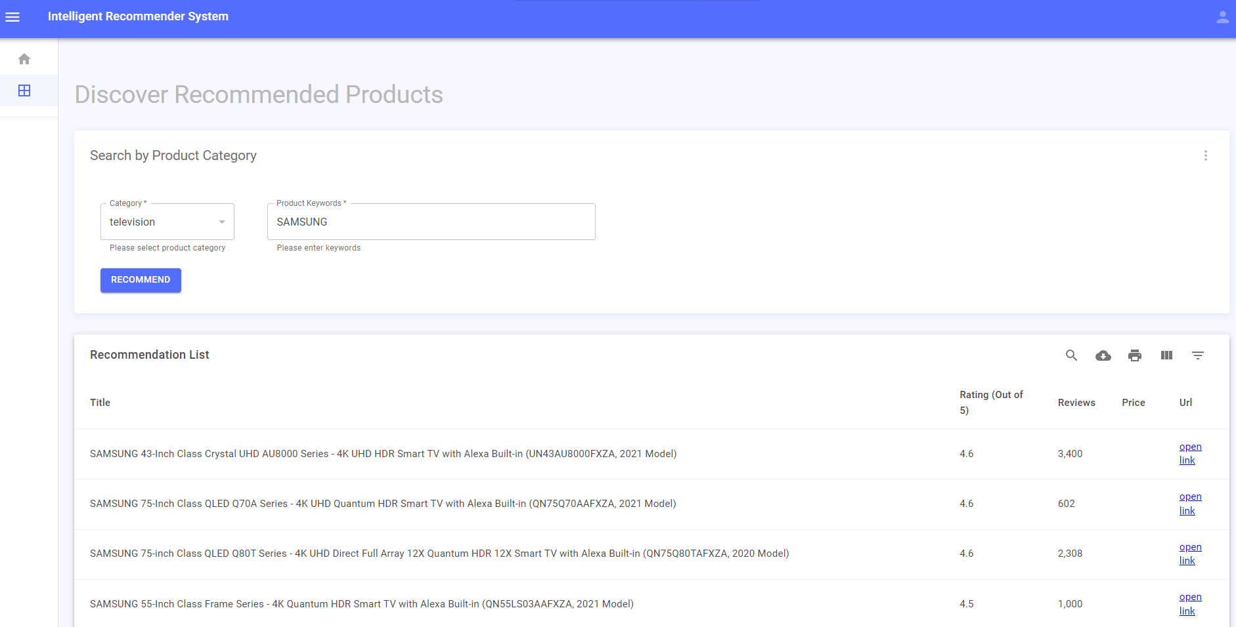
Use Case 3 Category as “television” and keyword as “SAMSUNG”

Slide 10
Thank You

